Slide 1
Networking in Azure

Slide 2
Introducing the Virtual Network
Virtual Networks allow you to define the IP space used
IP space used is typically from RFC 1918 but does not have to be
10.0.0.0 - 10.255.255.255 (10/8 prefix)
172.16.0.0 - 172.31.255.255 (172.16/12 prefix)
192.168.0.0 - 192.168.255.255 (192.168/16 prefix)
You can divide into Virtual Subnets to separate traffic
Virtual Networks are bound to an Azure region
Up to 2048 VMs in a Virtual Network
Pick IP space NOT used on-premises
VMs created in new portal are always in a Virtual Network as are VMs created via ARM
VMS can be in different Resource Group from that of the Virtual Network
Notes:
Previously a Virtual Network was created within an Affinity Group however this is no longer the case and if you had virtual networks within an Affinity Group over time they will be converted to a regional virtual network
http://azure.microsoft.com/blog/2014/05/14/regional-virtual-networks/
ARM – Azure Resource Manager. Must specify Virtual network as part of creation/template

Slide 3
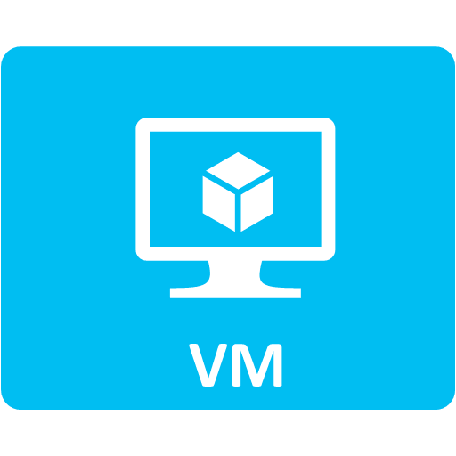
Virtual Network
Virtual Subnet
Virtual Subnet
Virtual Network
Region
Notes:
You can still create a virtual network within affinity group but need to manually edit network configuration files
Create Virtual Network before you do anything
Create VM in the virtual subnet.
All VMs in same Virtual Network can communicate even if in different virtual subnets

Slide 4
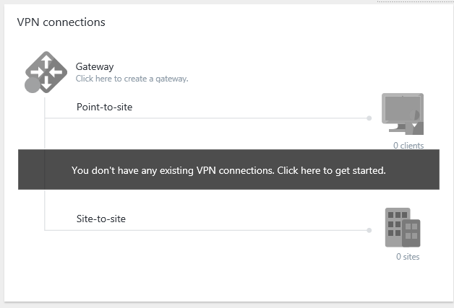
Create a Virtual Network
For ARM resources use non-classic type
Create New Virtual Network
Specify required settings including name, location, address space and resource group
Once created view Settings to configure additional options such as DNS servers
Click in VPN connections to configure Point-to-site and Site-to-site VPNs
Notes:
Walk through in detail
Explain subnet used by gateway. Trick create a subnet starting high (change the main IP range first), create gateway so its at start then remove and create others
Note can modify but only if does not affect an in-use subnet
http://msdn.microsoft.com/en-us/library/azure/dn133803.aspx – FAQ
The smallest subnet we support is a /29 and the largest is a /8 (using CIDR subnet definitions). We reserve some IP addresses from each subnet.

Slide 5
Lab
4.1 – Create Virtual Network – over lap considerations – 30 min
5.1 – Create a VM – 45 min

Slide 6
Supported types of IP traffic
Standard IP-based protocols supported including:
TCP
UDP
ICMP
Multicast, broadcast, IP-in-IP encapsulated packets and Generic Routing Encapsulation (GRE) blocked
You cannot ping the Azure gateway or use tools such as tracert or network sniffers in promiscuous mode
No IPv6 support
Traditional Layer 2 VLANs are not supported
Routing can be customized to support virtual network appliances in Azure
Notes:
Network sniff in promiscuous won’t work

Slide 7
IP Configuration
VMs must ALWAYS be configured to use DHCP
VM IP can be viewed through the Dashboard of the VM
DIP can change if VM is deallocated from Azure fabric
VMs in a Virtual Network can have an IP reserved
Must be configured using PowerShell or preview portal
Notes:
Always DHCP in VM
Reserved VIP for cloud service option

Slide 8
IP Reservation for a VM with PowerShell
Test-AzureStaticVNetIP -VNetName VirtNet115 -IPAddress 10.7.115.25
$staticVM = Get-AzureVM -ServiceName SavServ -Name savazudc01
Set-AzureStaticVNetIP -VM $staticVM -IPAddress 10.7.115.25 | Update-AzureVM
Get-AzureStaticVNetIP -VM $staticVM
Notes:
Separate virtual subnets for static and those dynamic

Slide 9
Virtual Network Security
Virtual Networks are completely isolated from each other
A virtual network can be thought of as a trust boundary
Network Security Groups enables ACLs to be defined to control traffic between virtual subnets/Internet
Rules added to a NSG based on 5 tuple

Slide 10
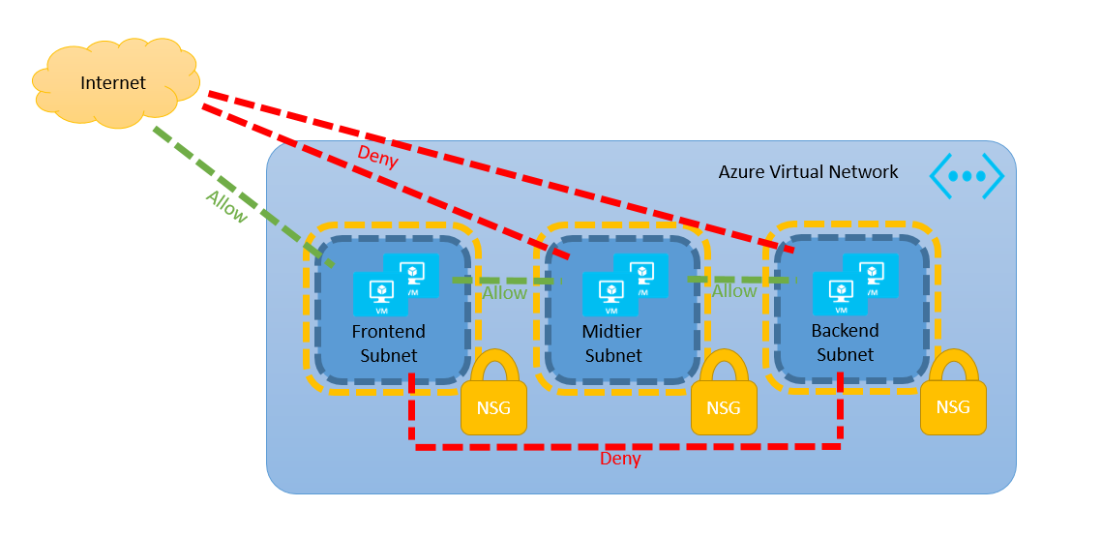
Network Security Groups
Notes:
New-AzureNetworkSecurityGroup -Name "NSGFrontEnd" -Location "East US" `
-Label "NSG for FrontEnd in East US"
Get-AzureNetworkSecurityGroup -Name "NSGFrontEnd" |
Set-AzureNetworkSecurityRule -Name WEB -Type Inbound -Priority 100 `
-Action Allow -SourceAddressPrefix 'INTERNET' -SourcePortRange '*' `
-DestinationAddressPrefix '*' -DestinationPortRange '*' -Protocol TCP
Get-AzureNetworkSecurityGroup -Name "NSGFrontEnd" -Detailed
Get-AzureNetworkSecurityGroup -Name "NSGFrontEnd" | Remove-AzureNetworkSecurityRule -Name SQL
#Associate a NSG to a Virtual machine
Get-AzureVM -ServiceName $service -Name $VM |
Set-AzureNetworkSecurityGroupConfig -NetworkSecurityGroupName "NSGFrontEnd"
#Remove a NSG from a VM
Get-AzureVM -ServiceName $service -Name $VM |
Remove-AzureNetworkSecurityGroupConfig -NetworkSecurityGroupName "NSGFrontEnd"
#Associate a NSG to a subnet
Get-AzureNetworkSecurityGroup -Name "NSGFrontEnd" |
Set-AzureNetworkSecurityGroupToSubnet -VirtualNetworkName 'VNetTest' -SubnetName 'FrontEndSubnet'
#Remove a NSG from the subnet
Get-AzureNetworkSecurityGroup -Name "NSGFrontEnd" |
Remove-AzureNetworkSecurityGroupFromSubnet -VirtualNetworkName 'VNetTest' -SubnetName 'FrontEndSubnet'
#Delete a NSG
Remove-AzureNetworkSecurityGroup -Name "NSGFrontEnd"

Slide 11
Connecting Azure to On-premises

Slide 12
External Connectivity
Internet
Load Balancer with VIP
PIP
Virtual Subnet
Virtual Subnet
Virtual Network
Region
Notes:
This is not really ideal
It’s not efficient for everyone to be communicating via endpoints
No ability for Azure to communicate to on-premises systems and really no efficient way for on-premises systems to talk to Azure
Most likely don’t want to publish internal services by an Internet facing UNC path
Stress note each cloud service has own VIP. A reason to have multiple cloud services is to get those multiple VIPS

Slide 13
Site-to-site VPN
Once a Virtual Network exists a site-to-site VPN can be configured to enable on-premises to Azure connectivity
Enables all devices on-premises and in Azure to communicate
This is an IPSEC (IKEv2) encrypted connection over the Internet
You need a gateway device on your premises with a public IP that Azure can connect to
Many different devices supported
http://msdn.microsoft.com/en-us/library/azure/jj156075.aspx
Notes:
We generate a pre-shared key (PSK) when we create the VPN gateway. You must use the PSK to authenticate. The PSK can be re-generated at any time and the PSK length can be changed as needed.
What is a static-routing gateway?
Static routing VPNs are also referred to as policy-based VPNs. Policy-based VPNs encrypt and route packets through an interface based on a customer-defined policy. The policy is usually defined as an access list.
What is a dynamic-routing gateway?
Dynamic routing VPNs are also referred to as route-based VPNs. Route-based VPNs depend on a tunnel interface specifically created for forwarding packets. Any packet arriving on the tunnel interface will be forwarded through the VPN connection.

Slide 14
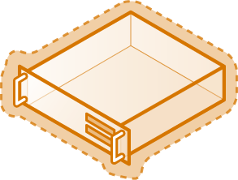
Site-to-site VPN
VPN Gateway
On Premises
Internet
PIP
Virtual Subnet
Virtual Subnet
VPN Gateway
Virtual Network
Region
Notes:
This is not really ideal
It’s not efficient for everyone to be communicating via endpoints
No ability for Azure to communicate to on-premises systems and really no efficient way for on-premises systems to talk to Azure
Most likely don’t want to publish internal services by an Internet facing UNC path
Stress note each cloud service has own VIP. A reason to have multiple cloud services is to get those multiple VIPS

Slide 15
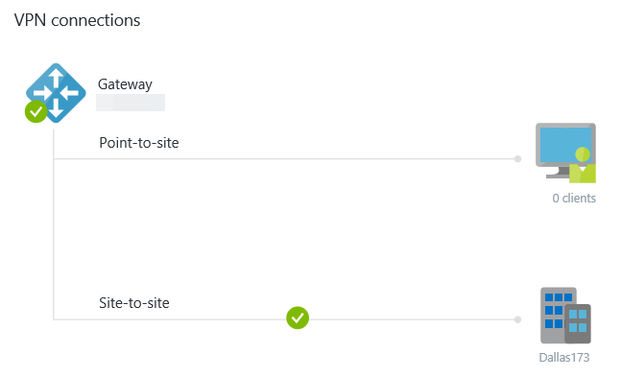
Create Site-to-Site VPN Gateway
You need to know the IPv4 address of your gateway
Ensure it’s a supported device
Know all the subnets used on-premises
Virtual Network needs to have the S2S VPN enabled
Ensure a Gateway subnet is added to the Virtual Network
Once the Virtual Network is created add the gateway using Create Gateway and select Dynamic or Static Routing depending on the gateway device used on-premises
Connection will be established
Azure is now an extension of your network
Notes:
Walk through in detail. Just create a new virtual network
Explain subnet used by gateway. Trick create a subnet starting high (change the main IP range first), create gateway so its at start then remove and create others
What is the “gateway subnet” and why is it needed?
We have a gateway service that we run to enable cross-premises connectivity. We need 2 IP addresses from your routing domain for us to enable routing between your premises and the cloud. We require you to specify at least a /29 subnet from which we can pick IP addresses for setting up routes.
Please note that you must not deploy virtual machines or role instances in the gateway subnet.
What is a static-routing gateway?
Static routing VPNs are also referred to as policy-based VPNs. Policy-based VPNs encrypt and route packets through an interface based on a customer-defined policy. The policy is usually defined as an access list.
What is a dynamic-routing gateway?
Dynamic routing VPNs are also referred to as route-based VPNs. Route-based VPNs depend on a tunnel interface specifically created for forwarding packets. Any packet arriving on the tunnel interface will be forwarded through the VPN connection.
2012 RRAS requires dynamic routing

Slide 16
Site-to-site VPN Details
2 VMs in an Active/Passive configuration
Computationally intensive IPSEC used to secure data which typically means around 80 Mbps of throughput
High performance gateway uses larger VMs with around 200 Mbps
Latency depends on routes taken over Internet and distance but common to see around 30 ms
Multiple virtual networks and on-premises locations can be connected together via S2S VPN (10 for standard, 30 for high performance)
Pay for egress data

Slide 17
ExpressRoute
Provides direct layer 3 connectivity between your network and your services in Azure giving a predictable path and therefore performance
Does not leverage public Internet but instead dedicated connectivity giving high security and isolation
High throughput, low latency
Available in unlimited data or metered data plans
Enables services such as storage, big data, backup/recovery, media and hybrid apps with improved connectivity
Two types of ExpressRoute connectivity
Network Service Provider (e.g. MPLS)
Exchange Provider
Notes:
https://azure.microsoft.com/en-us/documentation/articles/expressroute-locations/
http://azure.microsoft.com/en-us/pricing/details/expressroute/
http://azure.microsoft.com/blog/2014/06/02/expressroute-an-overview/
Not using crypto on the wire which is heavily CPU heavy
Can combine circuits
The higher bandwidth and lower latency enables new scenarios that were not possible before because of limits of connectivity
https://azure.microsoft.com/en-us/documentation/articles/expressroute-faqs/

Slide 18
Complementary Solutions

Slide 19
Azure Active Directory?
Consider todays world where users have multiple devices, accessing applications (SaaS) everywhere including Microsoft, Amazon, Salesforce etc etc
This means identities are needed in each “cloud” of service
The solution is federation enabling used of a single on-premises identity. Your organization could federate with partners however this can get highly complex to maintain
Azure Active Directory is an identity solution (not a true directory service) that has federations to all major services
Notes:
http://channel9.msdn.com/Events/TechEd/NorthAmerica/2014/DCIM-B382#fbid=
C:\Users\josavi\skydrive\NTFAQ Files\15may2014.htm for main http://windowsitpro.com/azure/azure-active-directory-vs-premises-active-directory
Deprovisioning a person in 20 companies very hard. 1 identity ideal
http://channel9.msdn.com/Series/Windows-Azure-Active-Directory/Windows-Azure-Active-Directory-Cartoon
http://windowsitpro.com/identity-management/overview-microsoft-azure-active-directory-premium
http://azure.microsoft.com/en-us/services/active-directory/
Link between - http://windowsitpro.com/hybrid-cloud/link-between-azure-ad-account-and-premises-ad-account
http://windowsitpro.com/azure/azure-active-directory-vs-azure-active-directory-premium
Sync - C:\Users\josavi\skydrive\NTFAQ Files\19jun2014.htm
The Active Directory capabilities that are part of Windows Server actually include a number of different roles such as Active Directory Certificate Service (ADCS), Active Directory Lightweight Directory Services (ADLDS), Active Directory Federation Services (ADFS), Active Directory Rights Management Services (ADRMS) however most people think of Active Directory as the Active Directory Domain Services role and is what people typically think of as "Active Directory" and is the focus when comparing to Azure Active Directory.
The reality is Active Directory Domain Services (henceforth just Active Directory) in Windows Server is completely different from Azure Active Directory (Azure AD) and really they have different focus areas. When you think about Active Directory you are talking about a true directory service that has a hierarchical structure (based on X.500) that uses DNS as its locator mechanism and can be interacted with via LDAP. Additionally for authentication it primarily uses Kerberos. Active Directory enables Organizational Units and Group Policy Objects in addition to actually joining machines to the domain and trusts are created between domains.
Azure AD while having some aspects of a directory service is really an identity solution and allows users and groups to be created but in a flat structure without OU's or Group Policy Objects. I cannot join a machine to Azure AD. There is no Kerberos authentication and I cannot query it via LDAP. This is OK as those things it does not have make sense on-premises where all types of communication are possible but Azure AD is focused around identity throughout the Internet where the types of communication are typically limited to HTTP (port 80) and HTTPS (port 443) and are used by all types of devices and not just corporate assets. Authentication is done through a number of protocols such as SAML, WS-Federation and OAuth. It is possible to query Azure AD but instead of using LDAP you use a REST API called AD Graph API. These all work over HTTP and HTTPS.
When you think about using Azure AD you will use it for authentication for Internet based services such as Office 365, Azure but much more including Facebook and 1000's of other services which are already federated with Azure AD which mean they trust Azure AD without you having to do anything other than enable that application/service to be used by your users.
For the best seamless experience you think about combining your on-premises Active Directory with Azure AD by setting up directory synchronization (including password sync) and federation. This allows users on their corporate assets to logon with their AD account and when they access Internet services, such as Office 365, authentication with Azure AD just happens via the federation seamlessly allowing access to all the different services that Azure AD is federated with. This is actually a great benefit of federating your on-premises AD with Azure AD. It is possible for your organization to federate with all the different companies out on the internet but this is a lot of work to setup and maintain. If however you just federate with Azure AD then you are now by proxy federated with all the organizations that Azure AD is federated with which is pretty much ALL of the major services out on the Internet today. Think of Azure AD as acting like a federation hub for you!

Slide 20
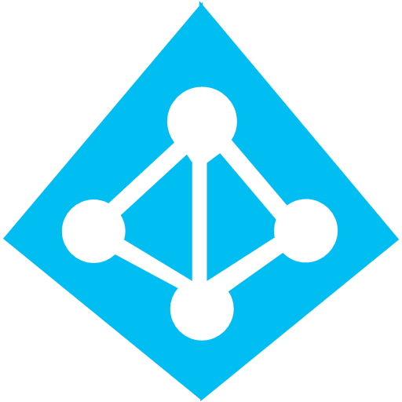

How it can work
Microsoft Apps
Active Directory Domain Services
Microsoft Azure
Active Directory
Non-Microsoft Apps
Other directory
Notes:
There is also a basic version http://azure.microsoft.com/en-us/pricing/details/active-directory/
WALK THROUGH THE DIFFERENCES and key features and show
Office apps – Office 365, Windows Intune, Dynamics CRM
Non Microsoft – Facebook, AWS, Salesforce etc etc
Basically means you only need one fedearation to Azure AD then can take advantage of all the federations Azure AD has to near thousands of SaaS available over the Internet
This means you can now control the partner services can be used. Also has a Cloud App Discovery tool that will give you a detailed report of how many and which applications your users are offering.
http://azure.microsoft.com/en-us/gallery/active-directory/ - all the applications that are federated with Azure AD
Can be cloud only if you don’t want to sync with on-premises but most likely you will want this.
When you think about using Azure AD you will use it for authentication for Internet based services such as Office 365, Azure but much more including Facebook and 1000's of other services which are already federated with Azure AD which mean they trust Azure AD without you having to do anything other than enable that application/service to be used by your users.
For the best seamless experience you think about combining your on-premises Active Directory with Azure AD by setting up directory synchronization (including password sync) and federation. This allows users on their corporate assets to logon with their AD account and when they access Internet services, such as Office 365, authentication with Azure AD just happens via the federation seamlessly allowing access to all the different services that Azure AD is federated with. This is actually a great benefit of federating your on-premises AD with Azure AD. It is possible for your organization to federate with all the different companies out on the internet but this is a lot of work to setup and maintain. If however you just federate with Azure AD then you are now by proxy federated with all the organizations that Azure AD is federated with which is pretty much ALL of the major services out on the Internet today. Think of Azure AD as acting like a federation hub for you!

Slide 21
Azure AD Connect and ADFS
Can manually create objects in Azure AD
Better option is Azure AD Connect (replaces DirSync) which synchronizes on-premises AD with Azure AD which can include password hash
Uses Forefront Identity Manager behind the scenes
Can also deploy ADFS so authentication is via the on-premises AD instead of the Azure AD
Can have password sync and ADFS configured
Notes:
Includes sync of the password hash (which is itself hashed again before being sent!)
FIM now is Microsoft Identity Manager (MIM)
Miisclient to actually view and see the configurations
http://windowsitpro.com/windows-server/control-dirsync-object-synchronization to control the objects actually being sync’d
PS C:\Program Files\Windows Azure Active Directory Sync\DirSync> .\ImportModules.ps1 PS C:\Program Files\Windows Azure Active Directory Sync\DirSync> Start-OnlineCoexistenceSync
ADFS and Password Sync http://social.technet.microsoft.com/wiki/contents/articles/17857.dirsync-how-to-switch-from-single-sign-on-to-password-sync.aspx
Got a nice stat about customers using federation vs password sync
statistically, it's 50/50 (we know who does which), but the 50% that do pw sync are small, and 50% federation are big customers. seat count wise, it's 75/25
http://msdn.microsoft.com/en-us/library/azure/dn688249.aspx – password write back to AD
http://windowsitpro.com/hybrid-cloud/link-between-azure-ad-account-and-premises-ad-account link between accounts
Q: What is the link between Azure AD and my on-premises AD account?
A: In "Azure Active Directory vs. On-Premises Active Directory," I discussed the difference between on-premises Active Directory (AD) and Azure Active Directory. Most organizations won't choose one approach over the other; instead, they'll use both because they achieve very different results. It's possible to use DirSync to replicate from on-premises AD to Azure AD, which can also include replication of password hashs—which means the same password can be used for on-premises AD and Azure AD. Some organizations will stop here, simply using the password replication so the two different security principals (AD and Azure AD) have the same password—which is a type of SSO.
The next step is to leverage federation—or more specifically, Active Directory Federation Services (AD FS)—to create a relationship between Azure AD and on-premises AD. With AD FS, when a user authenticates against services that leverage AD FS, the actual authentication is redirected to on-premises AD via AD FS and then a token passed back to the service from AD FS, consisting of claims about the user that's then used by the cloud service. For services that leverage Azure AD, such as Office 365, when a user authenticates using Azure AD with federation configured, the actual authentication is redirected to the organization's AD and the token that's returned contains an ImmutableID claim based on the AD user object ID per the AD FS rule created (as the following figure shows).
In Azure AD, that ImmutableID is used to find the corresponding Azure AD object, which the authenticated user now has the rights of. Note that the on-premises AD has no knowledge of Azure AD and has no link to which Azure AD account relates to an on-premises AD account.

Slide 22

Authentication Options
Identity sync with
Password hash
Microsoft Azure
Active Directory
Active Directory Domain Services
Identity sync
Microsoft Azure
Active Directory
Active Directory Domain Services
ADFS
Notes:
Could even mix, some users authenticate back to on-premises, some via Azure AD via the password sync (both experiences give user SSO experience)
Can also consider the Azure AD password sync as a backup if on-premises connectivity fails
In first scenario the user and password hash sync’d then authentication is against the Azure AD
In second scenario the user attributes are sync’d via identity sync but authentication is passed back to on-premises against windows server AD
Password hash is still optional if using bottom scenario

Slide 23
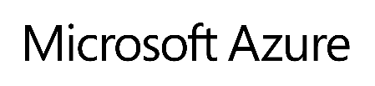
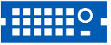

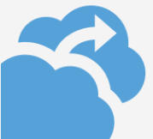

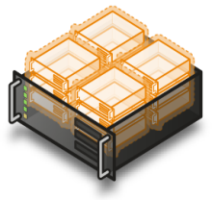
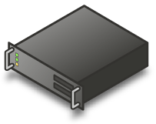
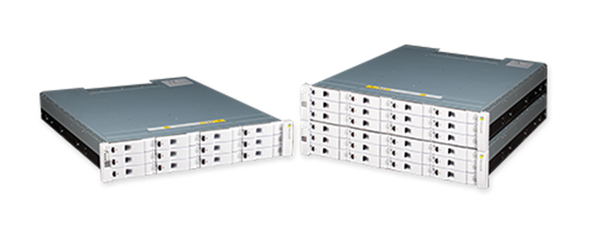
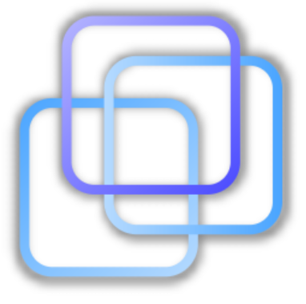

Azure Site Recovery
iSCSI
StorSimple Virtual Appliance
Hyper-V Replica replication
Encrypted Data
Scout
SCVMM
Private Cloud
Datacenter 1
Notes:
Have DR using HVR channel
Have DR from within guest OS from any hypervisor or physical to Azure through InMage Scout technology (or to Hyper-V)!
Can make data available in cloud via StorSimple and virtual appliance which can then be accessed by VMs in Azure over iSCSI
Remember don’t forget about DR for Azure itself of regions

Slide 24
Azure Backup
Simple to implement through Azure Backup to provide protection for Azure VMs and other services that leverage Azure Backup (such as on-premises workloads)
Open a Backup Vault and select Registered Items
Type of Azure Virtual Machine
Select Register and follow the wizard
Once VMs Registered then protect via Protected Items
Notes:
Takes time between register. Check via the Jobs view to make sure the status is complete

Slide 25
Azure Traffic Manager
A DNS service with load balancing, policy and endpoint monitoring capabilities
Resolves endpoints based on geographical location to the users local DNS server
Support various endpoints:
Azure Cloud Services (IaaS and PaaS)
Azure Web Sites
External endpoints
Notes:
Similar to Akamai to services

Slide 26




Traffic Manager in Action
Web App
Web App
Web App
Web App
Europe
US
Asia
5
Resolution
4
Azure
Traffic Manager
Contosowebapp1.trafficmanager.net
Alias to
3
Webapp.contoso.net (CName)
Contoso DNS Server
1
User makes request to local DNS server for
Webapp.contoso.net
Recursive DNS Query
2
Local DNS Server for users organization
Located in US
DNS Query
Notes:
http://windowsitpro.com/windows-azure/understand-azure-traffic-manager
http://azure.microsoft.com/blog/2014/06/26/azure-traffic-manager-external-endpoints-and-weighted-round-robin-via-powershell/
Show it. Note the endpoint can be a load balancer!

Slide 27

Azure Automation
Think of it as Orchestrator SMA in Azure
The ability to run PowerShell workflows in Azure (runbooks)
Enables a schedule to be defined when the automations should run
Includes an output windows to view execution if required
Not limited to Azure services. Can connect to any service that has an Internet endpoint
Do not use cmdlets that are based on interaction, e.g. FT
Consider use cases
Stop/start VMs at a certain time
Create new VMs based on scenarios
Patching VMs without downtime
Notes:
http://azure.microsoft.com/en-us/documentation/services/automation/
http://blogs.technet.com/b/keithmayer/archive/2014/04/04/step-by-step-getting-started-with-windows-azure-automation.aspx
Cmdlets that require interaction don’t workl

Slide 28
Azure RemoteApp
Azure Service that provides published applications via RDP
Hosted using a Windows Server 2012 R2 image that has Office and published using Remote Desktop Services
A RemoteApp client application is provided to enable launching of the applications
Can use your own image which you are then responsible for any OS and application updates
Infrastructure dynamically scales up and down based on demand
Notes:
Talk about Desktop as a Service.
Cannot license Windows Client in Azure
Can standard up Remote Desktop Services and things like Citrix to offer your own
Don’t have to use RemoteApp Azure service but rather just regular IaaS but then need to take care of licensing yourself where as Azure RemoteApp includes all licenses (http://azure.microsoft.com/en-us/pricing/details/remoteapp/)
Custom template - http://blogs.msdn.com/b/rds/archive/2014/07/15/microsoft-azure-remoteapp-you-can-now-create-cloud-deployments-with-your-own-template-image.aspx

Slide 29
Closing

Slide 30
Why should you use Azure?
Gartner has a magic quadrant around many technologies. The magic quadrant are leaders in their vision and ability to execute
Microsoft is in the leader magic quadrant for:
Cloud IaaS
X86 Server Virtualization
Enterprise Application PaaS
Public Cloud Storage Services
Azure and Hyper-V are leaders
Microsoft is the only company that can provide a leader hybrid solution
CHALLENGERS
LEADERS
ABILITY TO EXECUTE
NICHE PLAYERS
VISIONARIES
COMPLETENESS OF VISION
Notes:
http://www.gartner.com/technology/research/methodologies/research_mq.jsp
Gartner quadrants where azure is a leader
Also focus that Microsoft is in leader quadrant for
Cloud IaaS (Azure)
Enterprise Application PaaS (Hyper-V)
Public Cloud Storage Services
X86 Server Virtualization
Only leader in all four magic quadrants!!
Gartner hype cycle key for our customers and key is overall integration. 45 min of chapell video. Azr203

Slide 31
But what about feature x?
Peak of Inflated
Expectations
Focused on
Features
Plateau of
Productivity
Slope of
Enlightenment
Focused on
Integration
Trough of
Disillusionment
Technology
Trigger
Notes:
Lets look at a squiggle
Also called the Gartner Hype Cycle
This applies to Azure, Hyper-V and really anything in the world.
You initially get a technology
Initially it’s the best thing in the world. It can do x, it can do y
Then the trough, it can’t do z, its slower than I thought. It won’t make me coffee
Then start to understand really how it will work and how can benefit
Then finally get productive with it.
When in the peak of expectations you focus on features because at this point you don’t understand what technologies go with whichever technologies so its feature feature feature. Think cloud and not thinking hybrid. You just think “best-of-breed” without any thought to integration with the rest of your environment
Once technologies reach the plateau of productivity organizations care more about integration with their other technologies and the holistic complete solution.
Don’t get me wrong. I want features but don’t make a decision today on “a” feature. That feature will come and looking at the history of innovation in things like Azure and even Hyper-V it will come very soon

Slide 32
Getting Started
Identify ongoing strategy for provisioning and management
Decide on department, account and subscription hierarchy and create
Create resource groups
Create storage accounts
Create virtual networks
Determine and implement connectivity for users and/or to on-premises
Create VMs in virtual network
Utilize VM agent for maintenance of VMs (e.g. backup, malware definitions, PowerShell DSC etc.)
Notes:
Work out identity Azure AD

